Slide 1
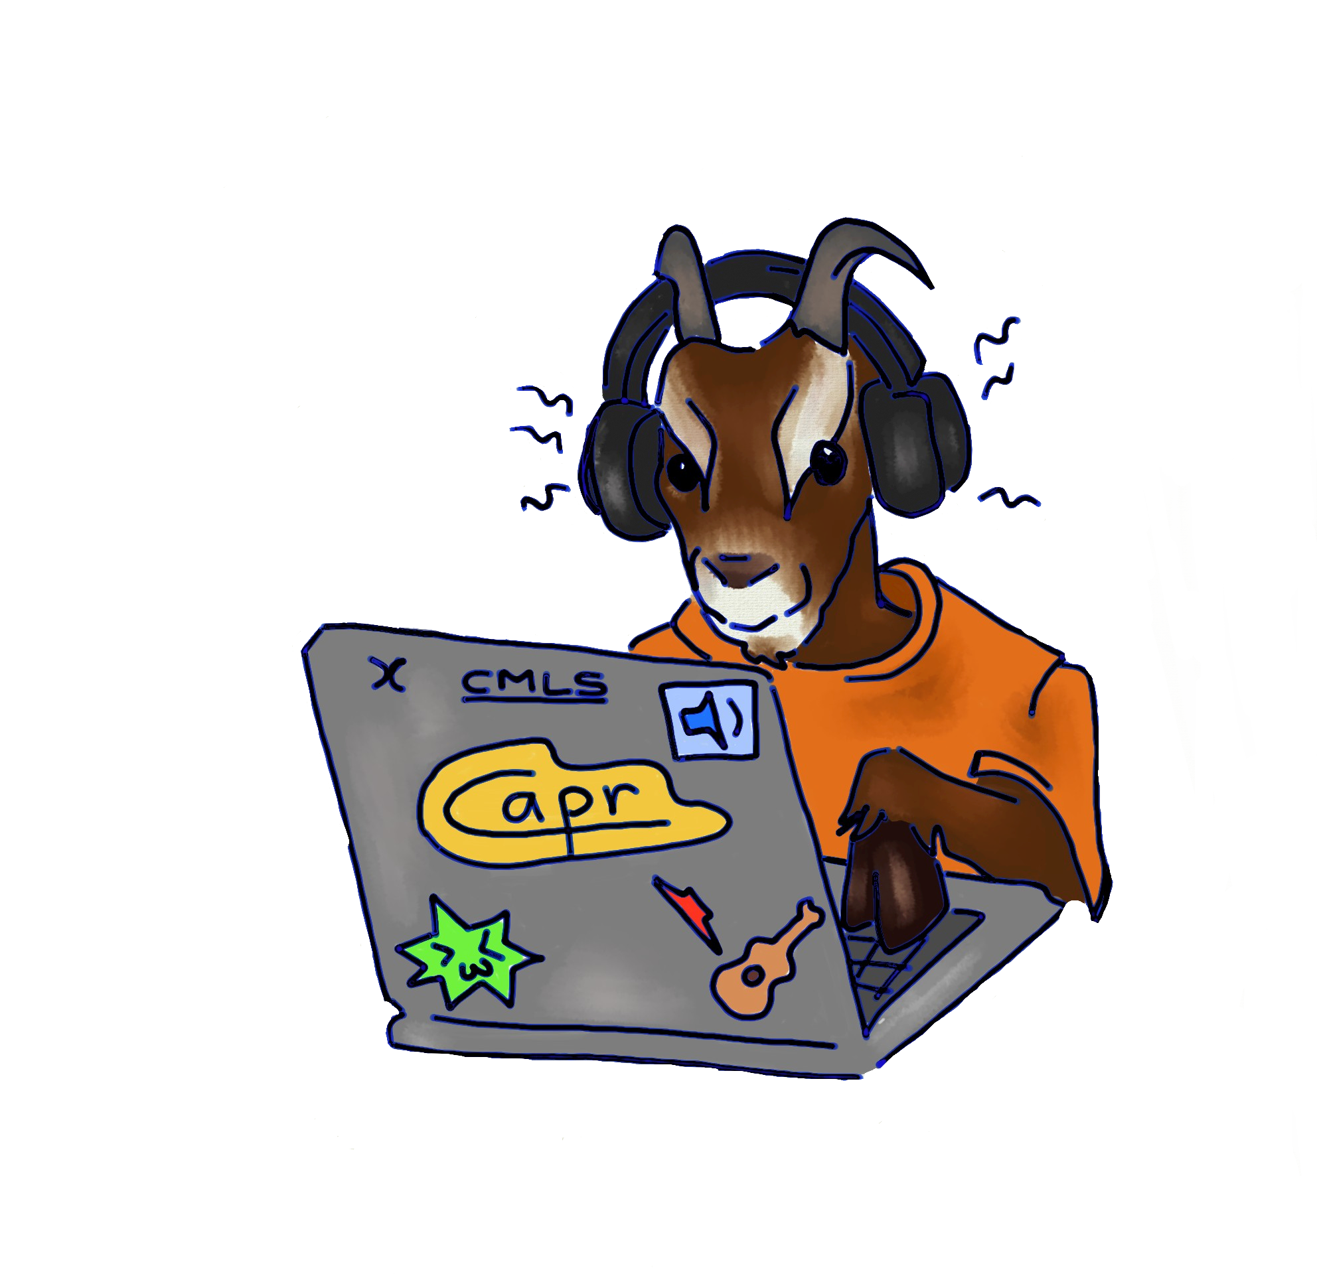

L’OTTAVATORE
SuperCollider Homework assignment #4
Computer Music: languages and Systems
Politecnico di Milano
Claudio Eutizi, Andrés Bertazzi, Pierluigi Tartabini, Riccardo Martinelli

Slide 2
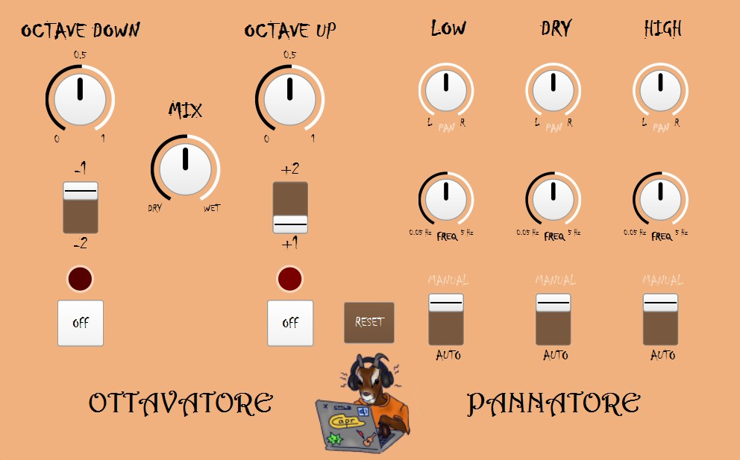

Slide 3
Structure of the project
GUI
Ottavatore
Pannatore
Reset
EFFECTS
Source group and pitch shift group
Panning group
Mix and master group

Slide 4
GUI

Slide 5
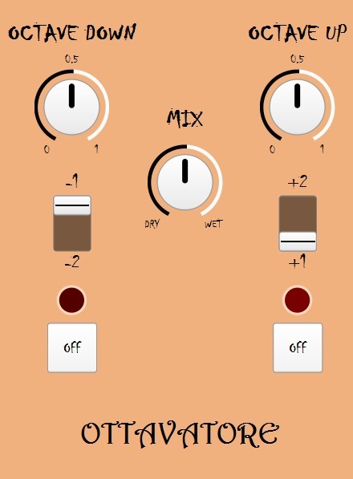
GUI
OCTAVE UP AND OCTAVE DOWN
SWITCHES
KNOB MIX
ON & OFF

Slide 6
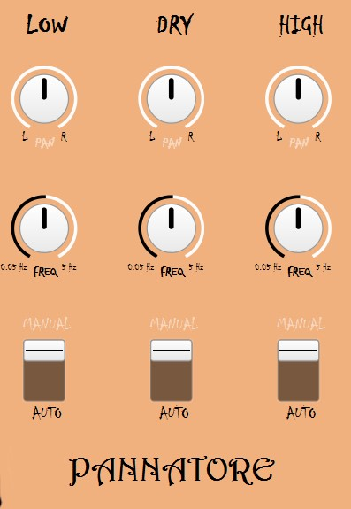
GUI
OCTAVE UP AND OCTAVE DOWN
SWITCHES
KNOB MIX
ON & OFF
PAN KNOB
FREQ KNOB
RESET

Slide 7
EFFECTS

Slide 8
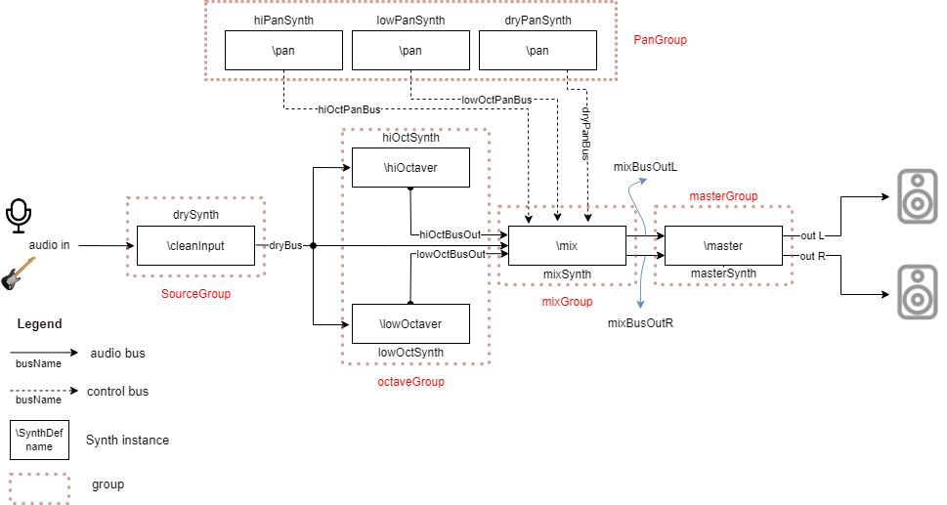

Slide 9
SYNTH

